Slide 1
Information Visualization Session 3: Understand Your Story

Slide 2
Agenda
Refine the question based on data
Data visualization styles
Technology and algorithms

Slide 3
refine the question based on data

Slide 4
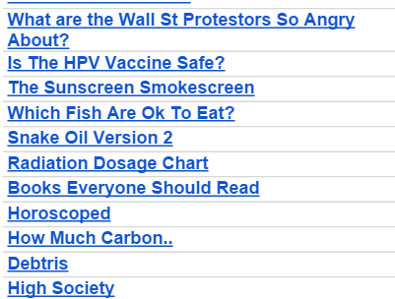
Work Your Way To The Question
The question primes your viewer
Visualizations don’t exist on their own
David McCandless
http://informationisbeautiful.net

Slide 5
The Question Will Drive the Visual Style
Size – Comparing similar values
Color – comparing disparate values
Location – Values related to places
Networks – connections between entities
Time – values changing over time

Slide 6
data visualization styles

Slide 7
Applying a Visual Metric
Size
Color
Location
Networks
Time

Slide 8
Visual Metric - Size
5
1
100

Slide 9

Visual Metric - Size

Slide 10

Visual Metric - Size

Slide 11


Slide 12


Slide 13


Slide 14
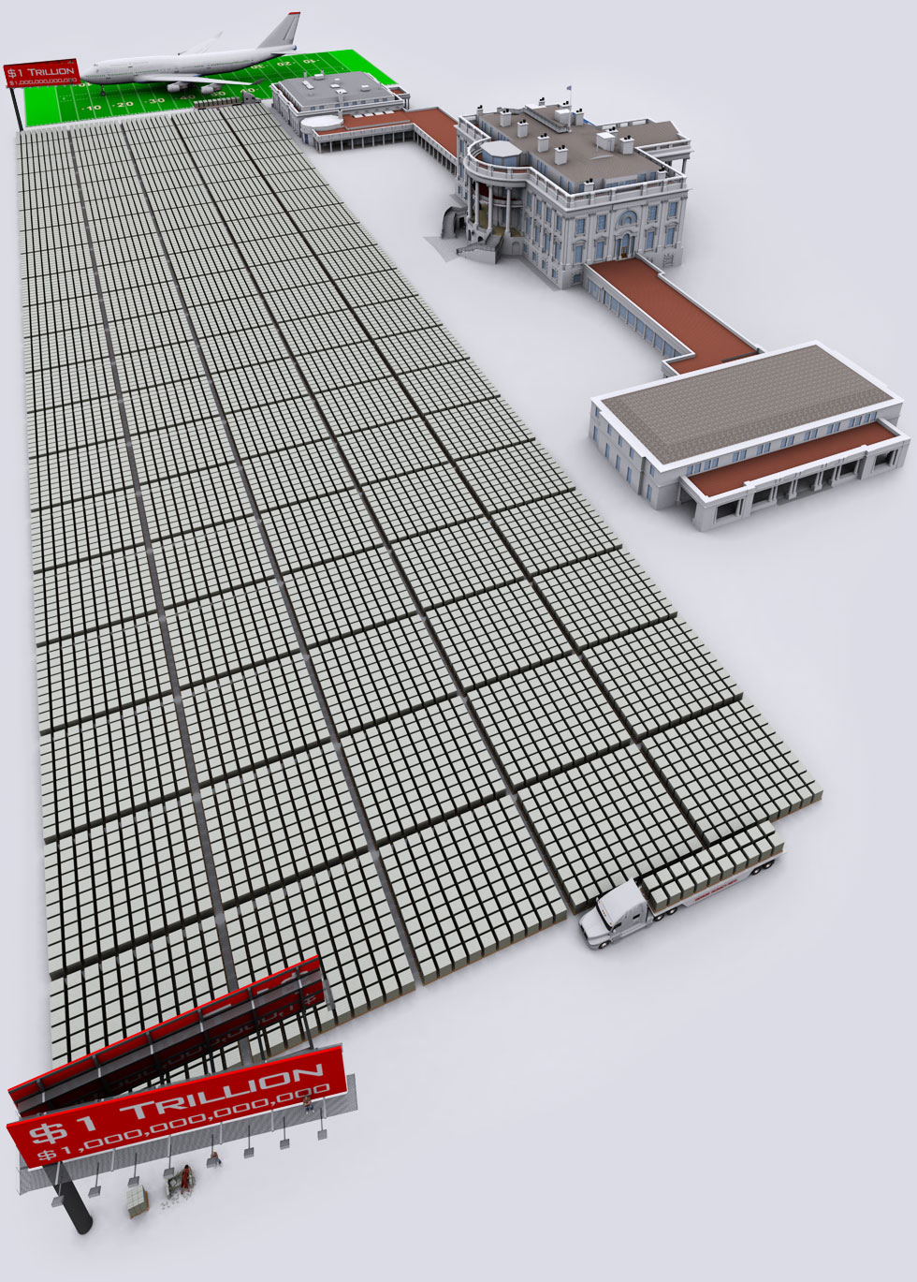

Slide 15


Slide 16
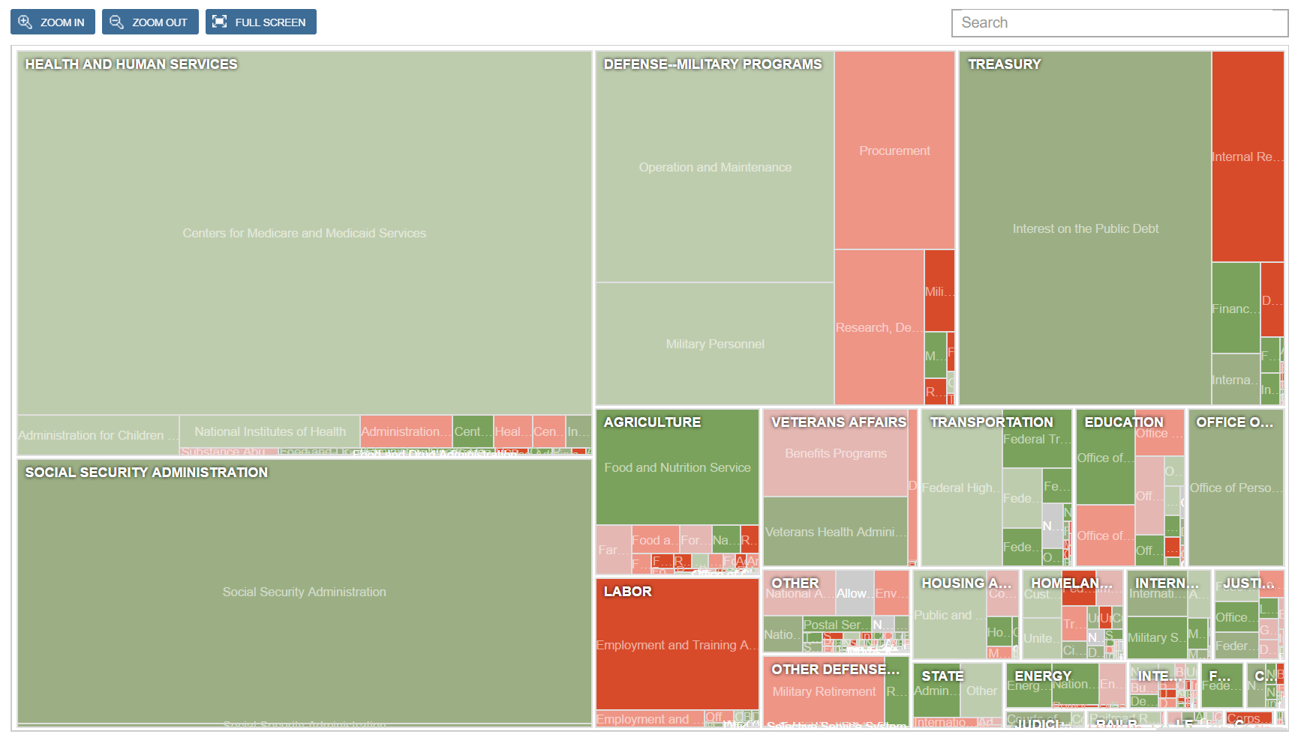
Ways to Show Size
Area (rectangles or circles)
http://www.nytimes.com/packages/html/newsgraphics/2011/0119-budget/index.html

Slide 17
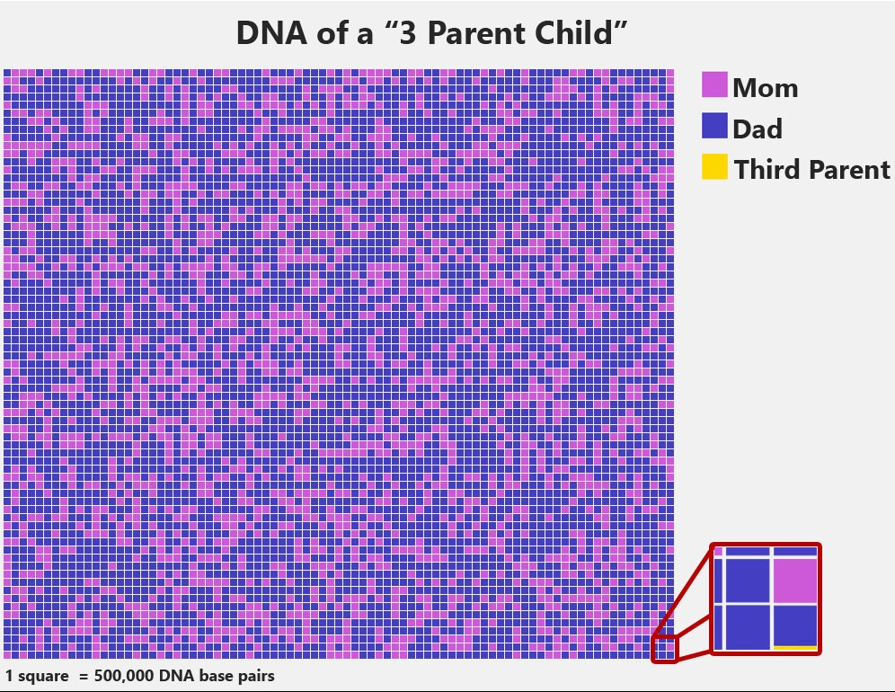
Atomic Unit

Slide 18
Size tools
Any graphic software (Excel)
Algorithmic calculations from Session 1
Excel Helpers

Slide 19
Visual Metric – Color
0
50
100

Slide 20
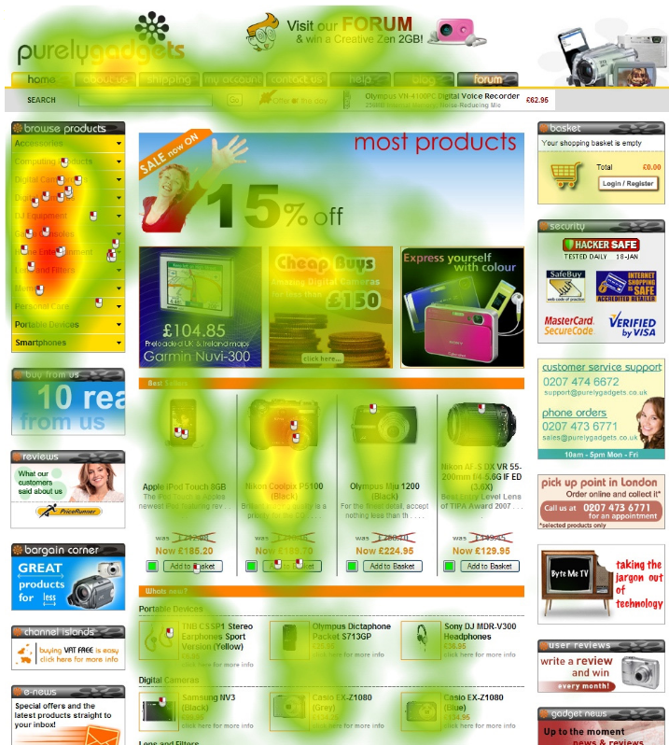
Visual Metric – Color
Gradient colors
Red-yellow-green
Red-blue
Shaded (light-to-dark)

Slide 21
Picking the right range
53
Not good for data with subtle value variation
46
Colors can wash out or change depending on display
0
100

Slide 22
Picking the right range
Not good for data with subtle value variation
53
Colors can wash out or change depending on display
46
40
60

Slide 23
Picking the right range
Not good for data with subtle value variation
53
Colors can wash out or change depending on display
46
40
60

Slide 24
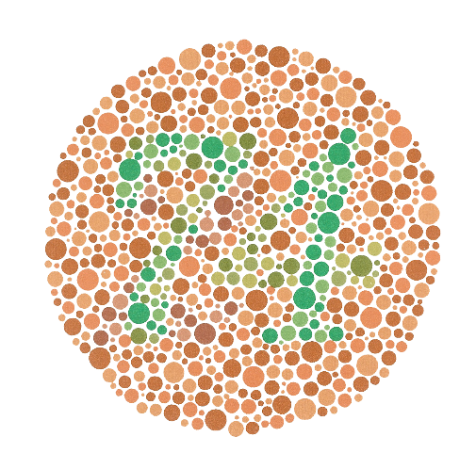
Picking the right range
4-5% of viewers are colorblind
0
50
100

Slide 25
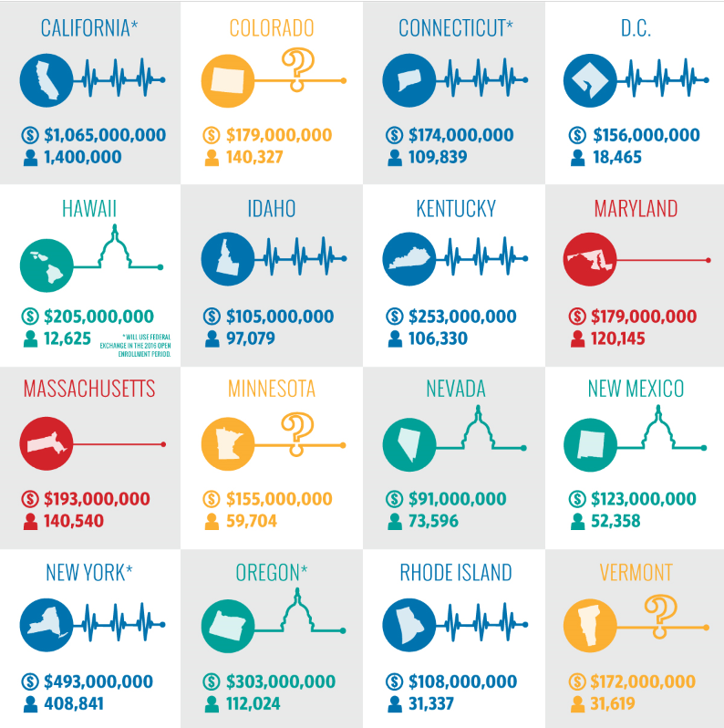

Visual Metric – Color
Color “buckets”
http://dailysignal.com/2015/06/08/how-the-16-state-exchanges-are-faring-under-obamacare/

Slide 26
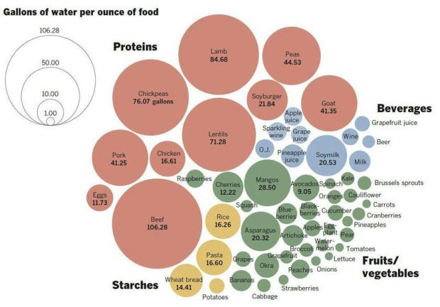
http://flowingdata.com/2015/04/07/gallons-of-water-to-produce-foods/

Slide 27
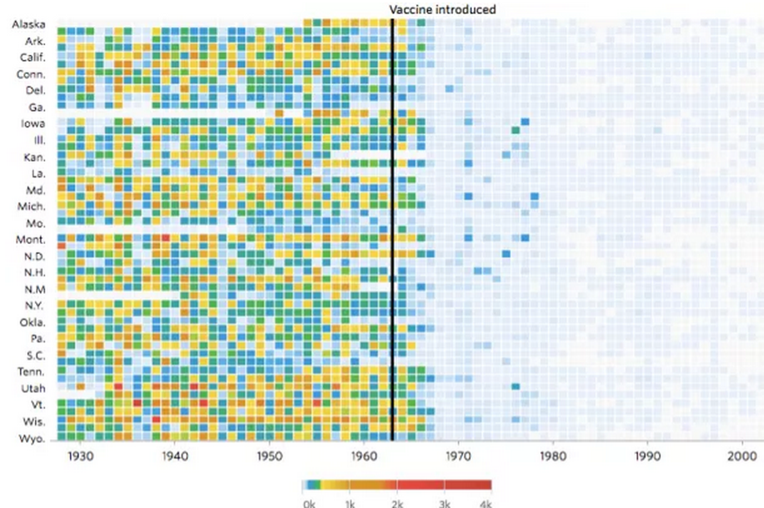
http://graphics.wsj.com/infectious-diseases-and-vaccines/

Slide 28
Color Metric Tools
Excel helpers for color

Slide 29
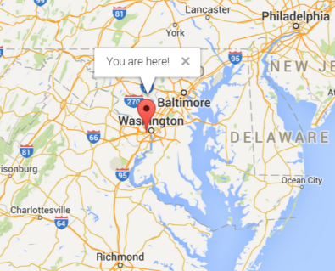
Visual Metric - Locations

Slide 30
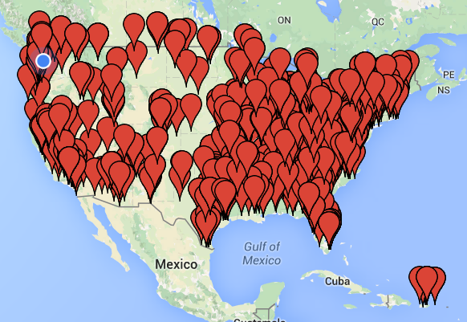
Visual Metric - Locations
Google Maps makes mapping latitude/longitude data points simple

Slide 31
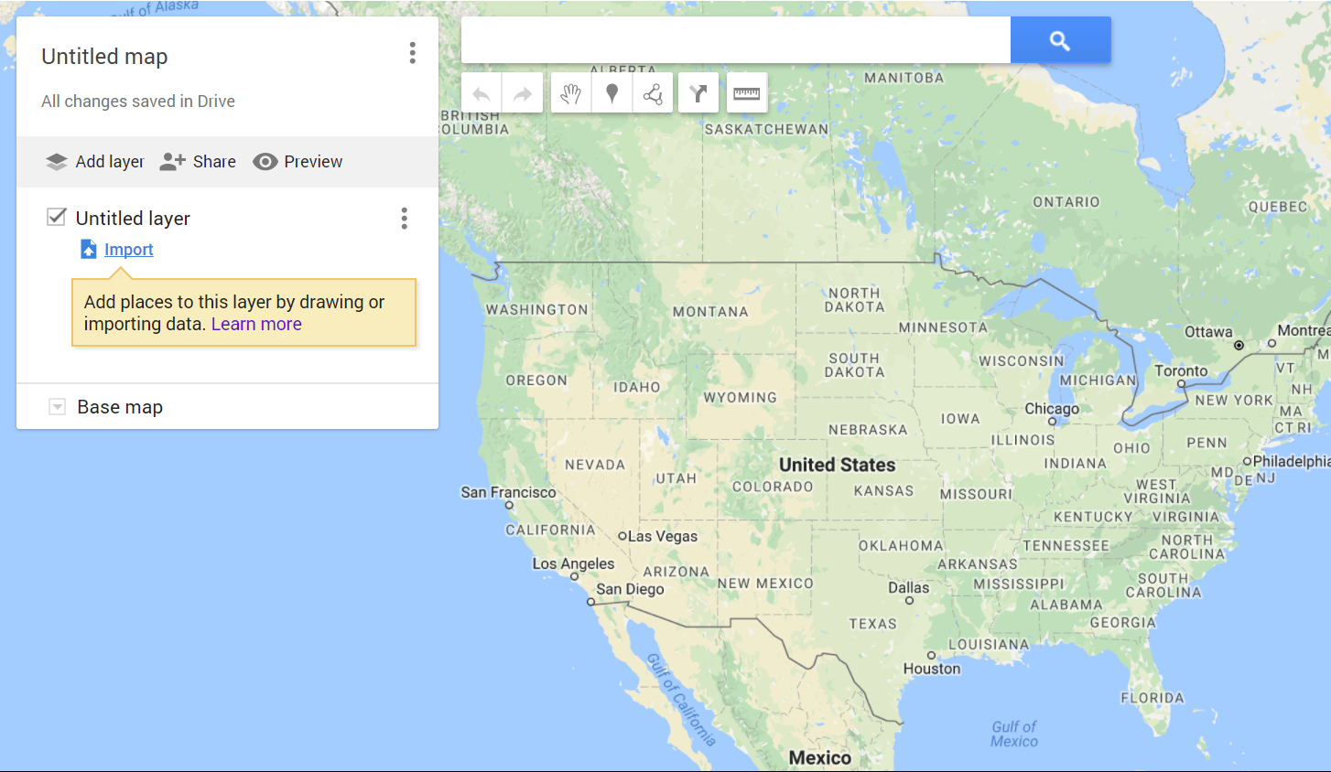
Visual Metric - Locations
Google Maps makes mapping latitude/longitude data points simple
google.com/maps/d

Slide 32
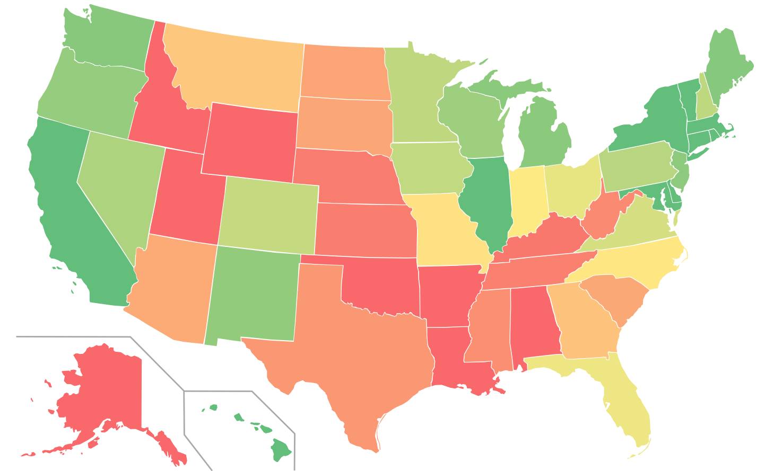
Visual Metric - Locations
Choropleth map

Slide 33
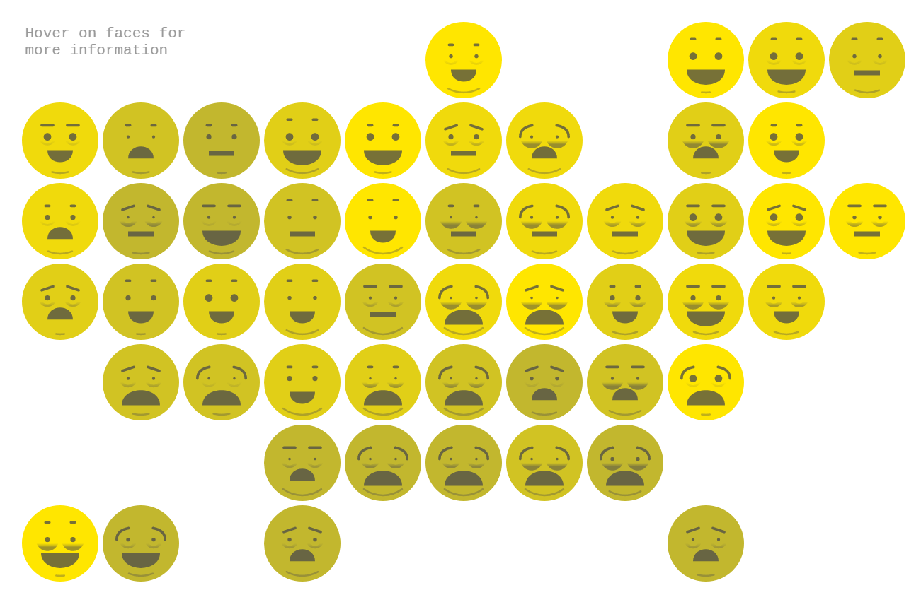
Visual Metric - Locations
The Emoji States of America
https://www.axios.com/an-emoji-built-from-data-for-every-state-2408885674.html

Slide 34
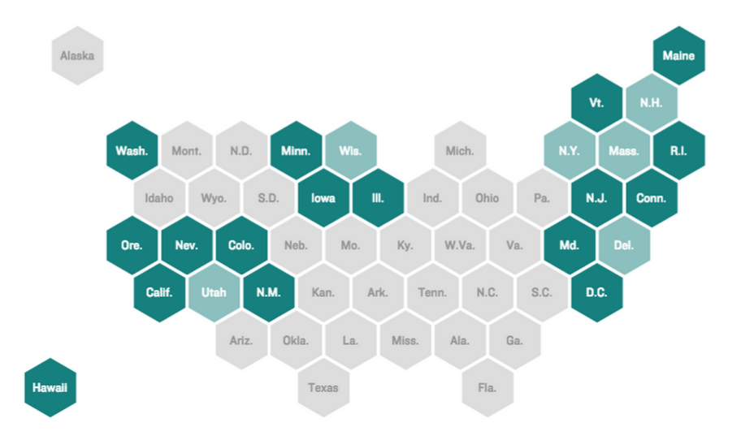
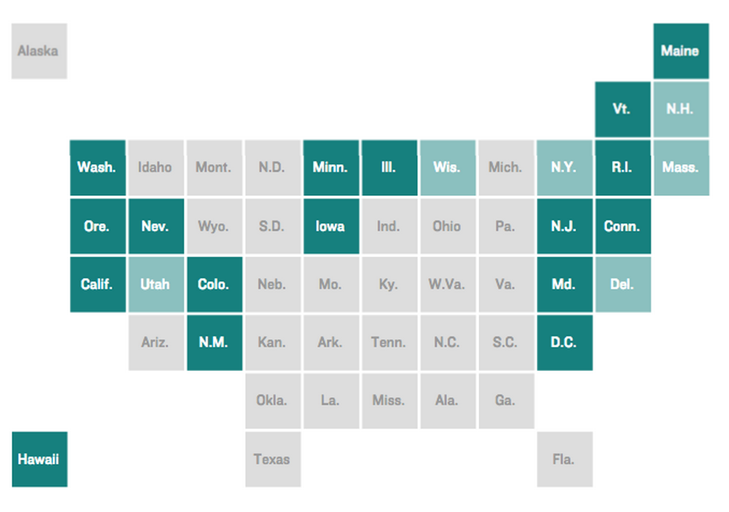
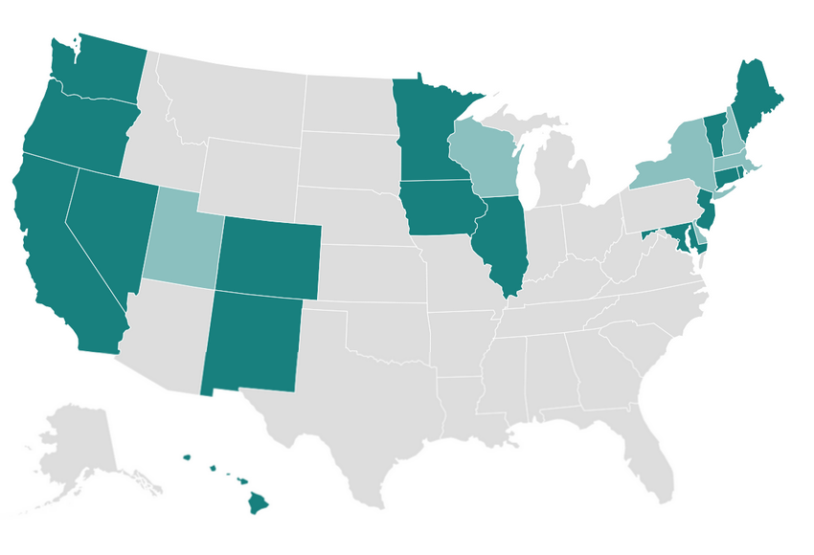
Visual Metric - Locations
http://blog.apps.npr.org/2015/05/11/hex-tile-maps.html

Slide 35
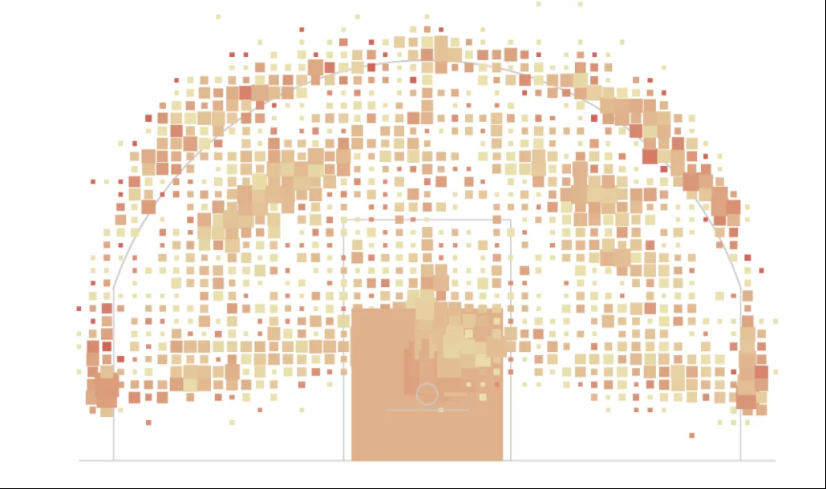
Visual Metric - Locations
Data mapped to any corresponding physical dimension

Slide 36
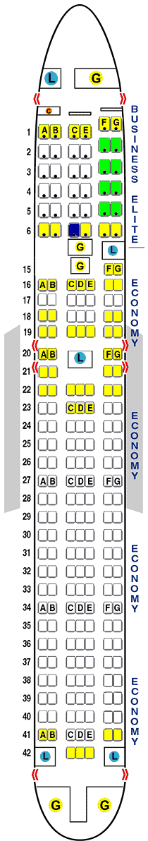
Visual Metric - Locations
Data mapped to any corresponding physical dimension
http://seatguru.com

Slide 37
Google Maps Demo

Slide 38




Visual Metric - Networks

Slide 39
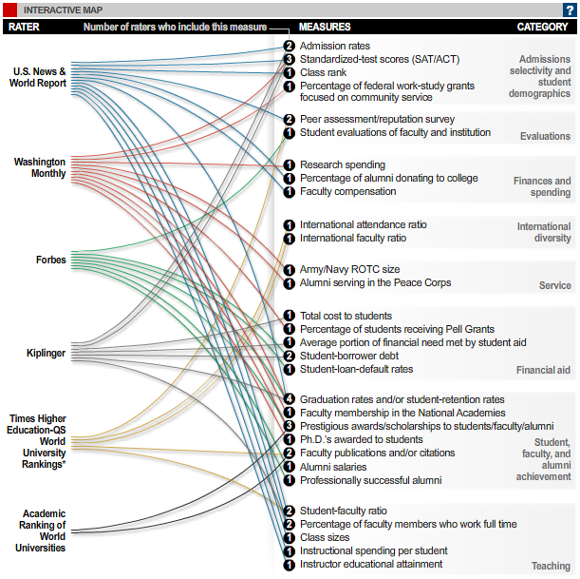
Visual Metric - Networks
Show connections between data points based on some true/false statement

Slide 40
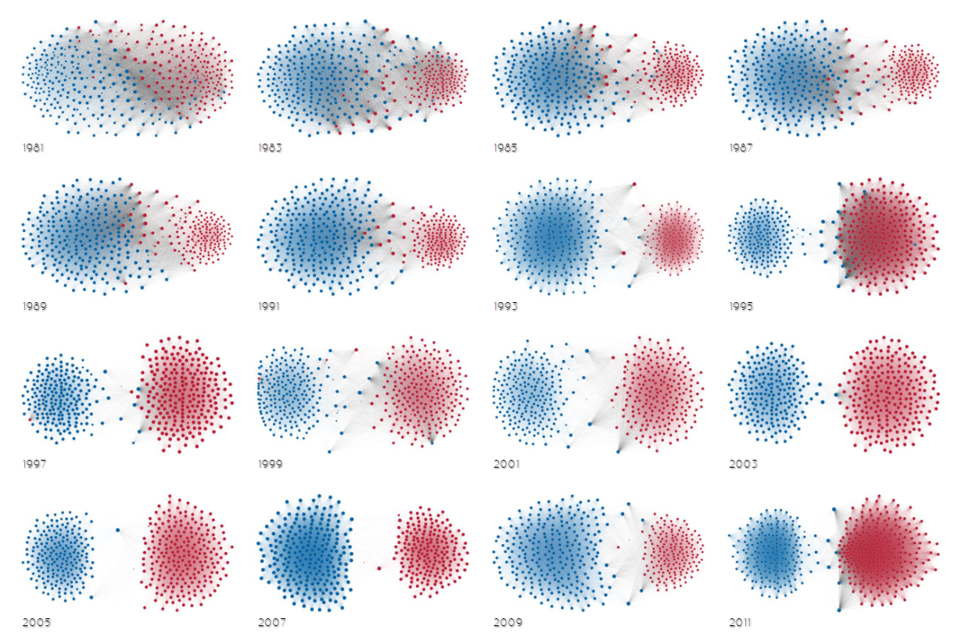
Visual Metric - Networks
force directed graph drawing
The Rise of Partisanship
http://www.mamartino.com/projects/rise_of_partisanship/

Slide 41
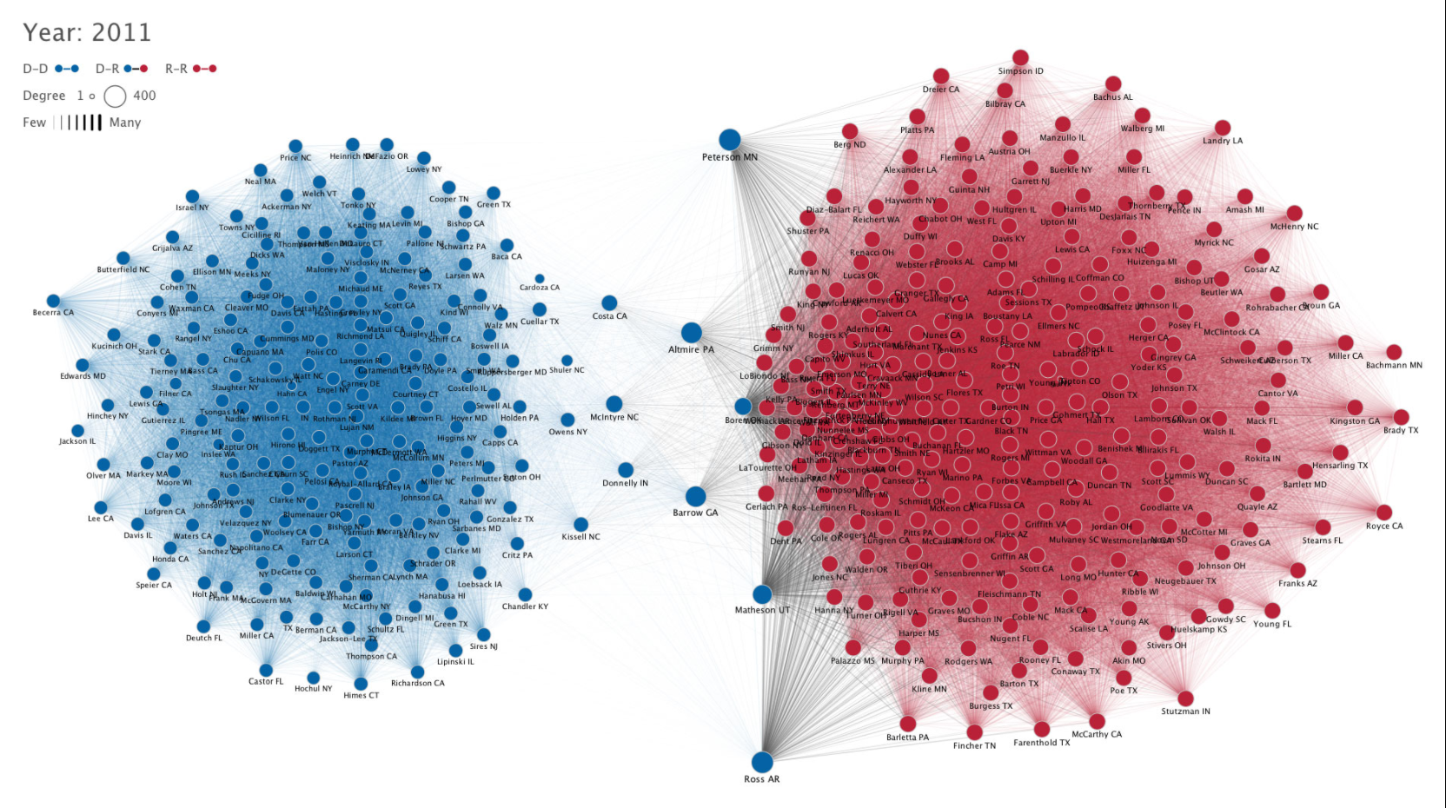
Visual Metric - Networks

Slide 42
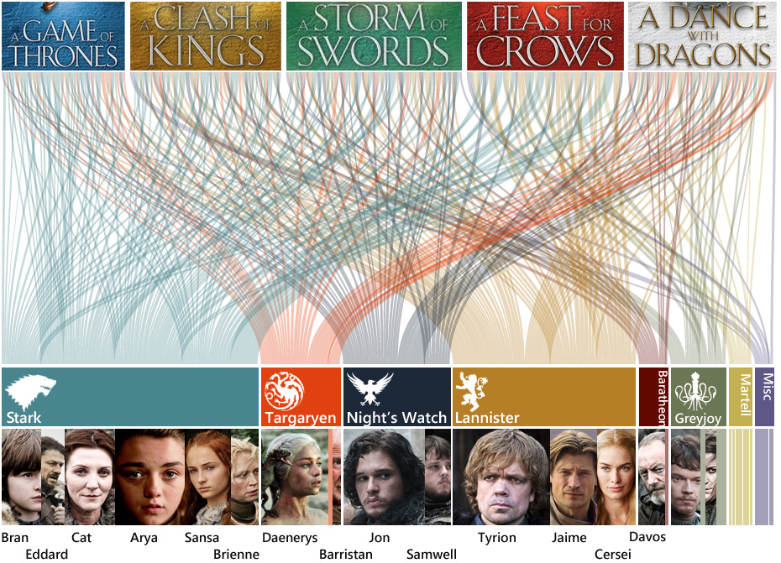
Visual Metric - Networks

Slide 43
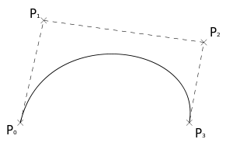
Visual Metric - Networks
Creating a bezier curve for networking visuals
x1,y1 – start point (P0)
x2,y2 – control point 1 (P1)
x3,y3 – control point 2 (P2)
x4,y4 – end point 1 (P1)

Slide 44
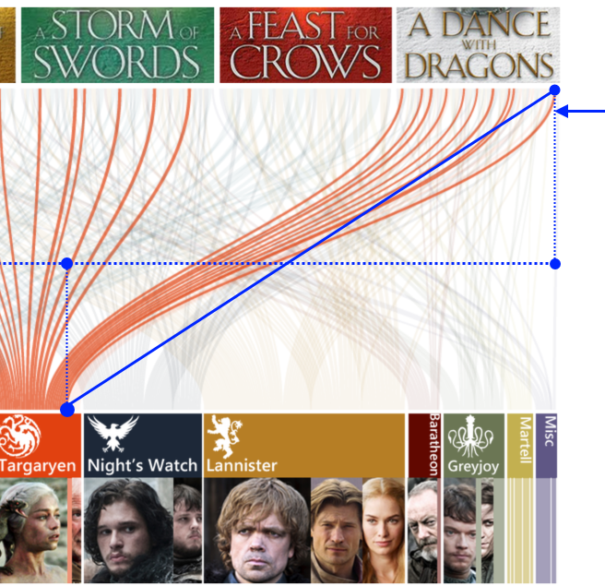
Visual Metric - Networks
Creating a bezier curve for networking visuals

Slide 45
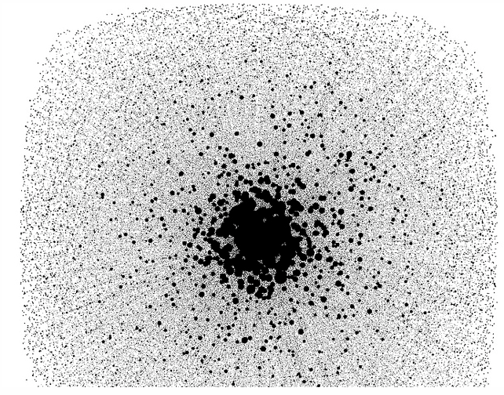
Visual Metric - Networks
limited when data set becomes too large
(1000’s of data points)

Slide 46
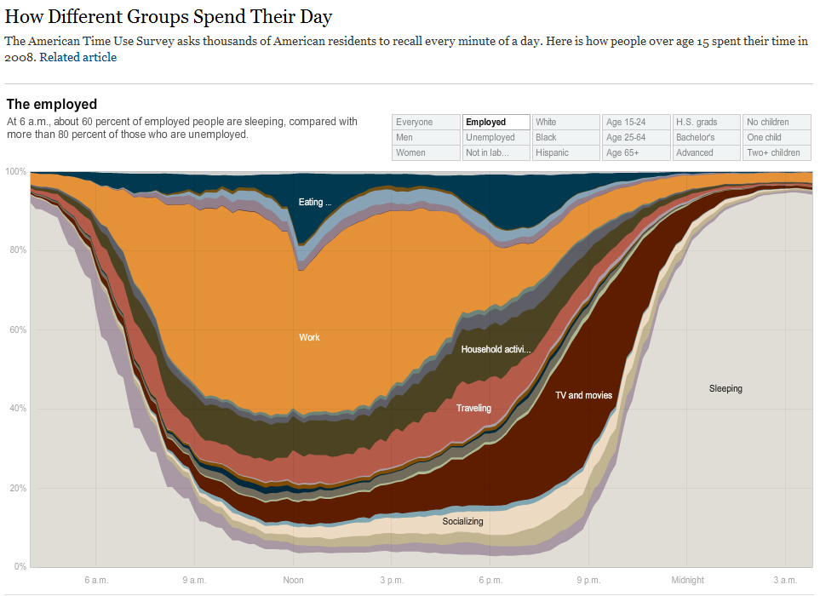
Visual Metric - Time
Data over time, expanded or contracted

Slide 47
Visual Metric - Time
Using animations to expand or contract time

Slide 48
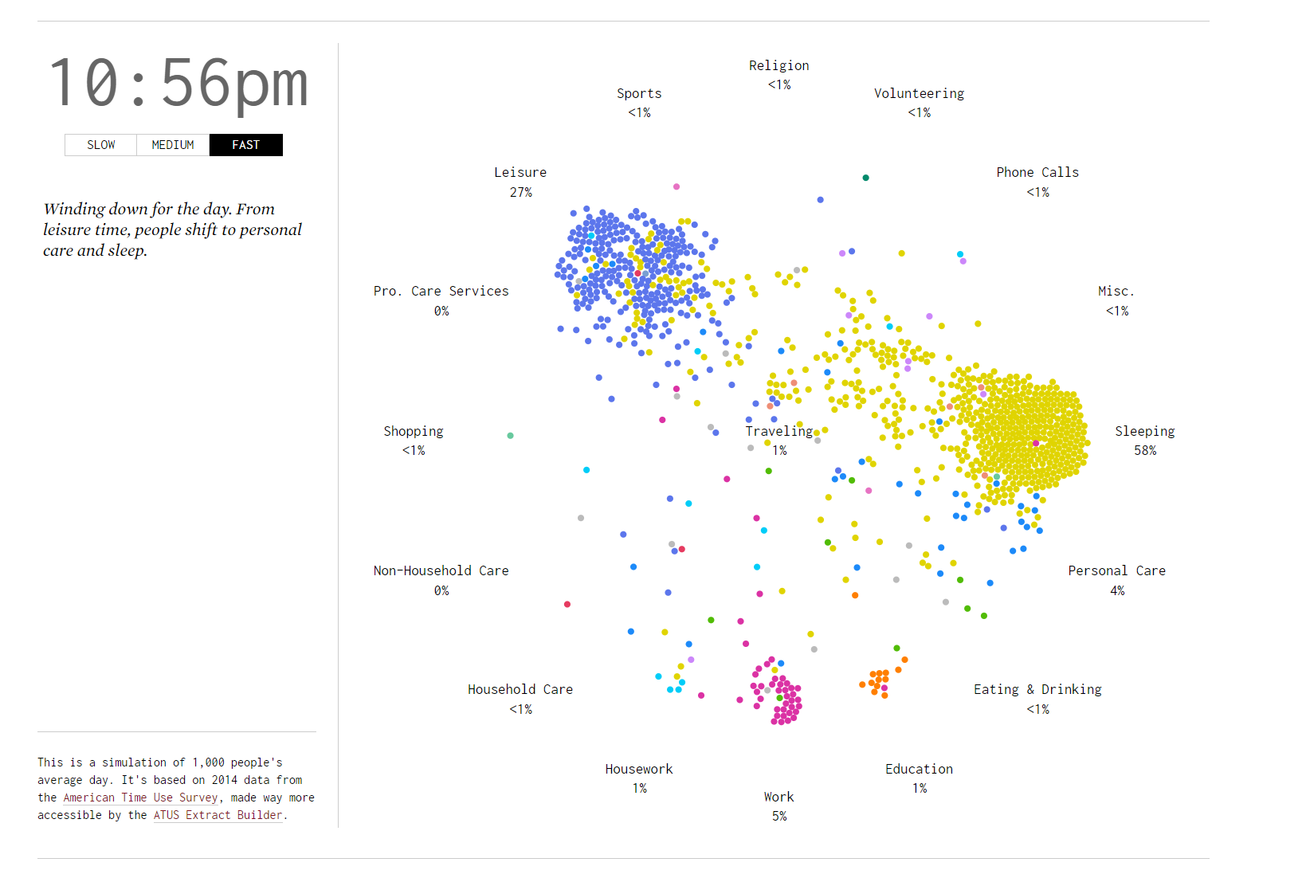
Visual Metric - Time
Using animations to expand or contract time
http://flowingdata.com/2015/12/15/a-day-in-the-life-of-americans/

Slide 49
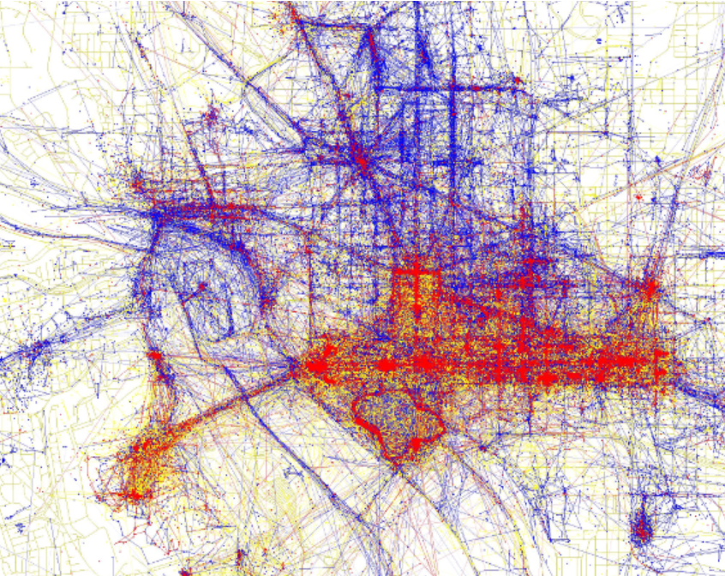
Using Multiple Metrics
Layering visual metrics to create multiple dimensions of meaning
https://www.flickr.com/photos/walkingsf/sets/72157624209158632/

Slide 50
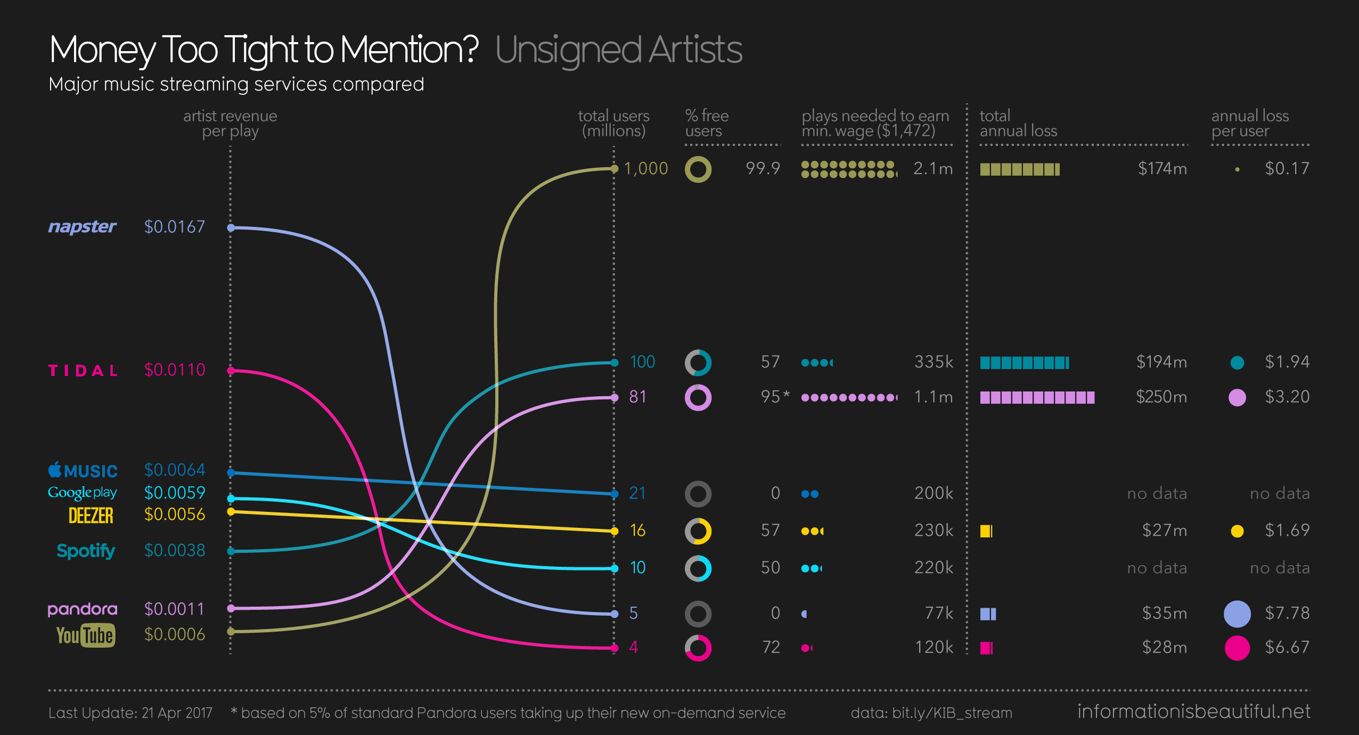
Using Multiple Metrics

Slide 51
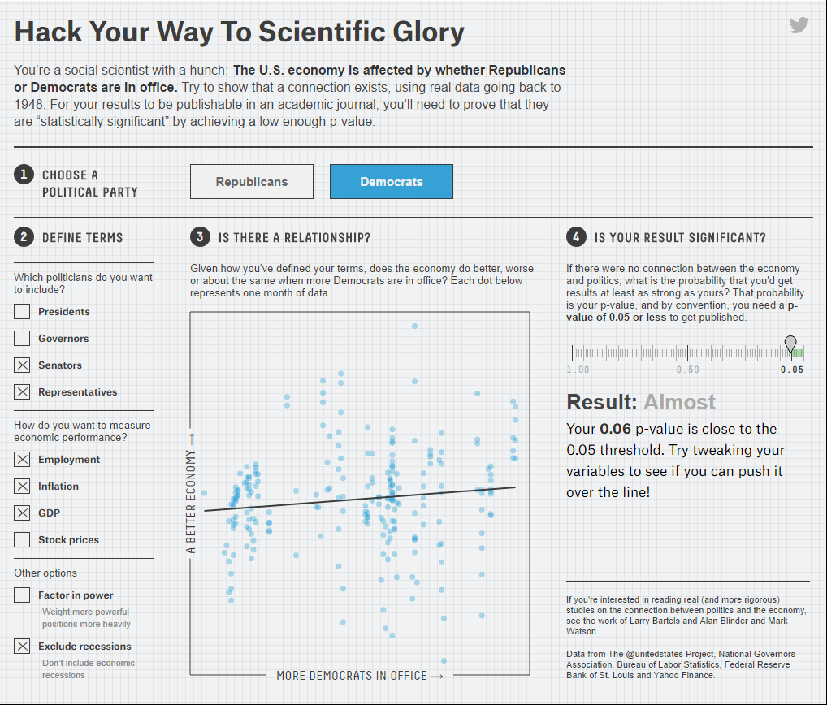
Interactivity
Create lasting impression through user data exploration
https://fivethirtyeight.com/features/science-isnt-broken/

Slide 52
technology and algorithms

Slide 53
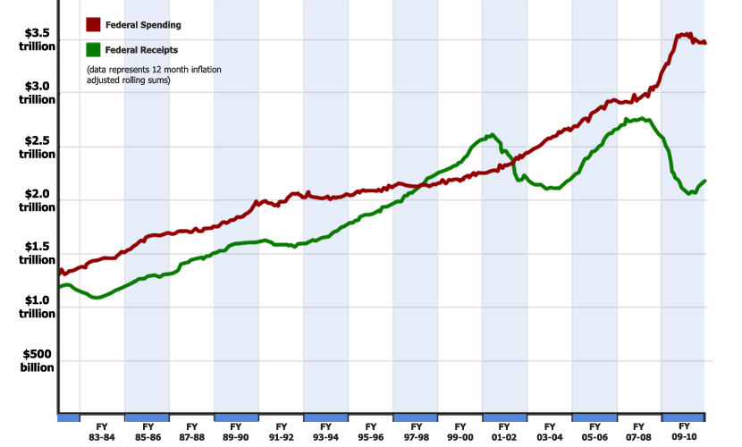
Excel + Photoshop
Create charts in Excel
Manipuate in Photoshop or Paint.NET (Windows)
or Gimp (Windows/Mac)

Slide 54
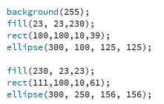
Processing
basic visual programming

Slide 55

Processing
created by Ben Fry, visualization pioneer
All examples from Visualizing Data are included

Slide 56
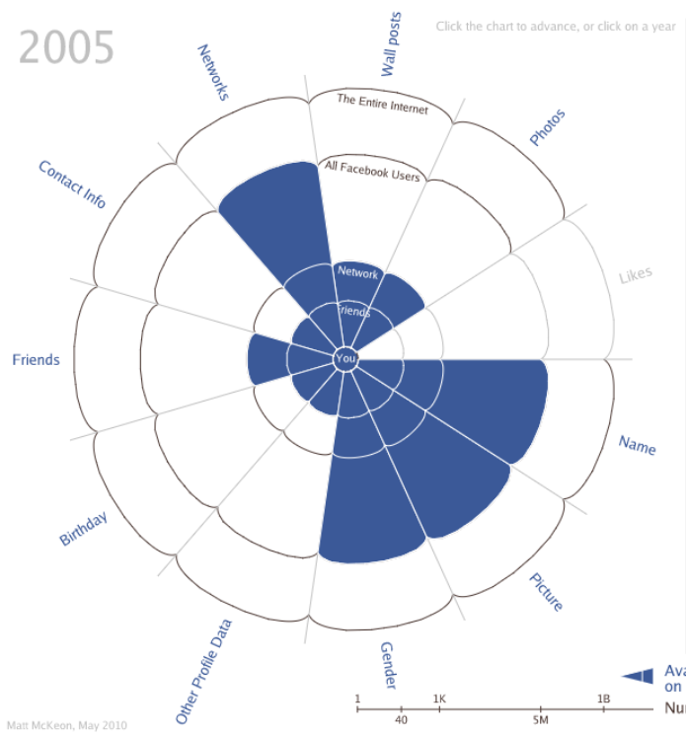
Processing.js
like Processing, but can be viewed on the web
Evolution of Facebook Privacy Matt McKeon

Slide 57
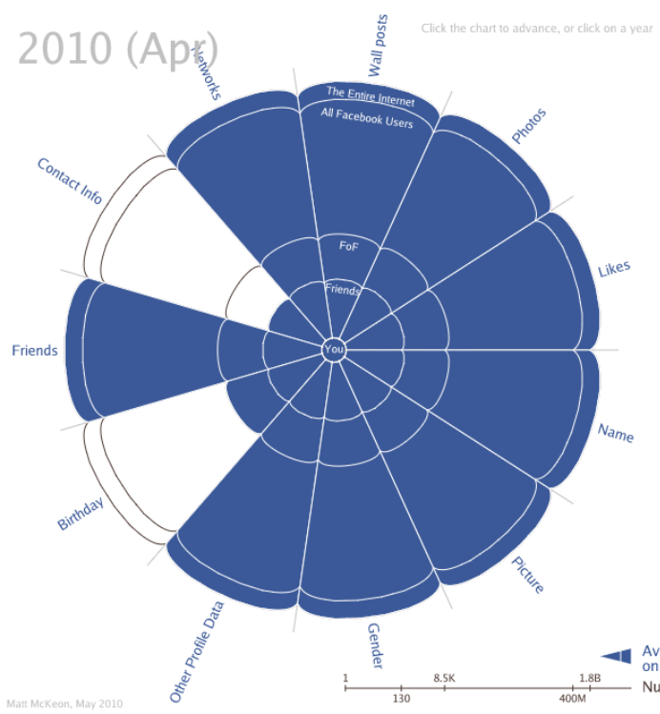
Processing.js
like Processing, but can be viewed on the web
Evolution of Facebook Privacy Matt McKeon

Slide 58

Processing.js
Khan Academy
https://www.khanacademy.org/hourofcode

Slide 59
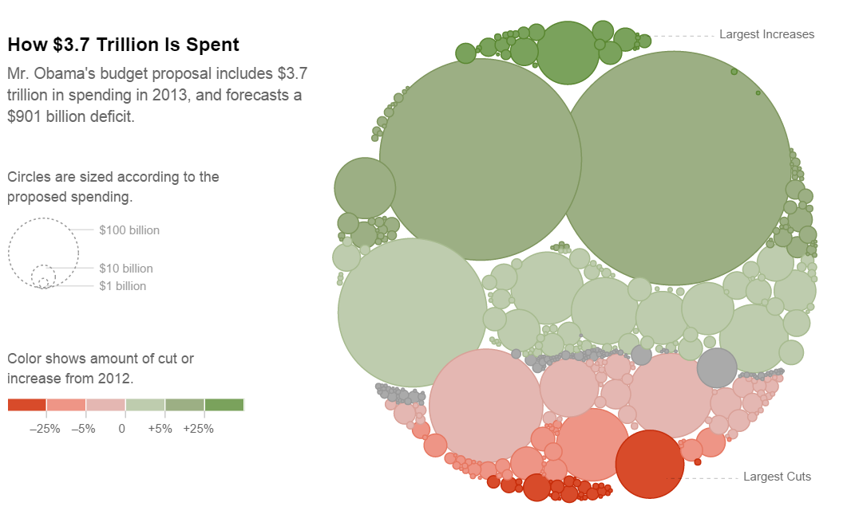
d3.js
Javascript library for visualization
Used by New York Times visualization team
Powerful but complex

Slide 60
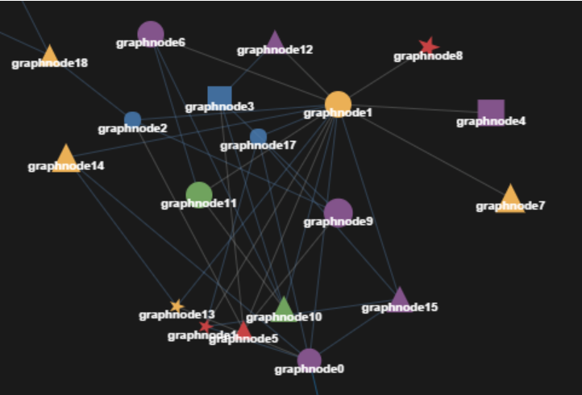
Javascript InfoVis Toolkit
Javascript library for visualization
Used by New York Times visualization team
Powerful but complex

Slide 61
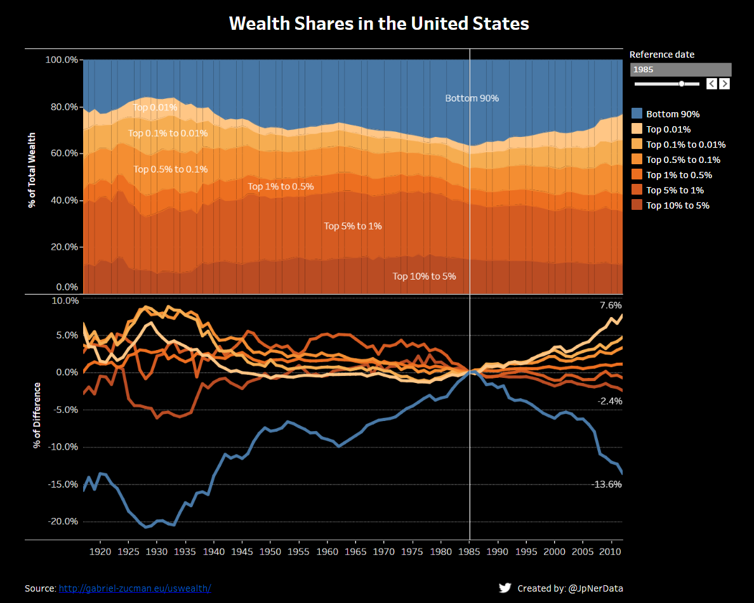
Tableau
Free to download / learn, can publish to the web
Import data (CSV)
Connect to databases (SQL, Oracle)
Web Data Connectors

Slide 62
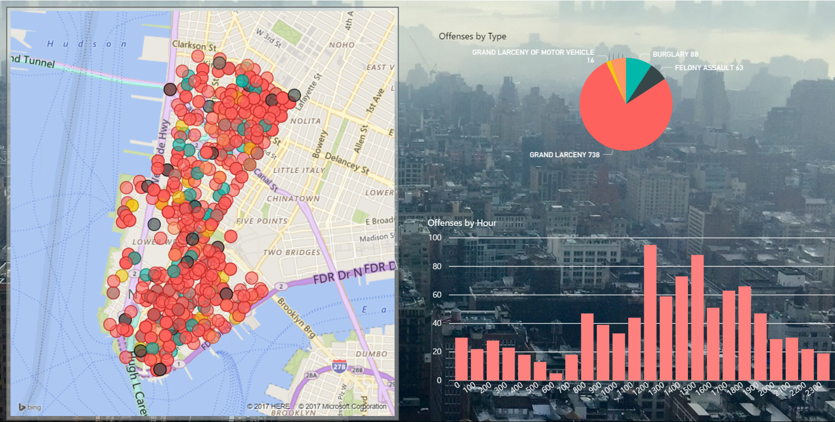
PowerBI
Integrates with Excel
Large set of data connectors
Good for data dashboards

Slide 63
Lab 3
Explore data with Excel charts
PowerBI for Choropleth Maps
Google Maps for mapping vis

